Slide 1
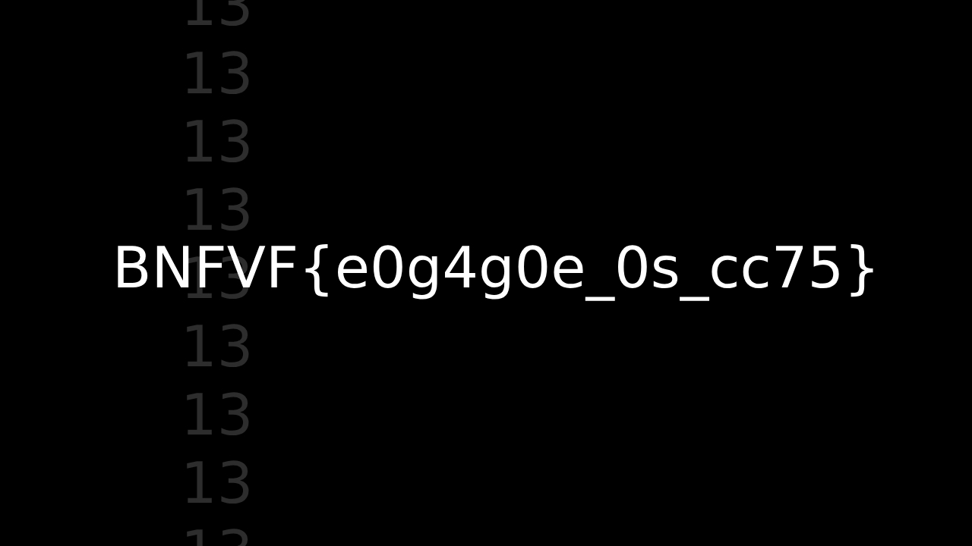
Hmmm

Slide 2
Flag isn’t here

Slide 3
Flag isn’t here either!

Slide 4
Where could it be?

